Slide 1
Inference Attack Against Graph Neural Networks

Slide 2
Outline
Story
Attack Models
Defense
Experimental Result

Slide 3
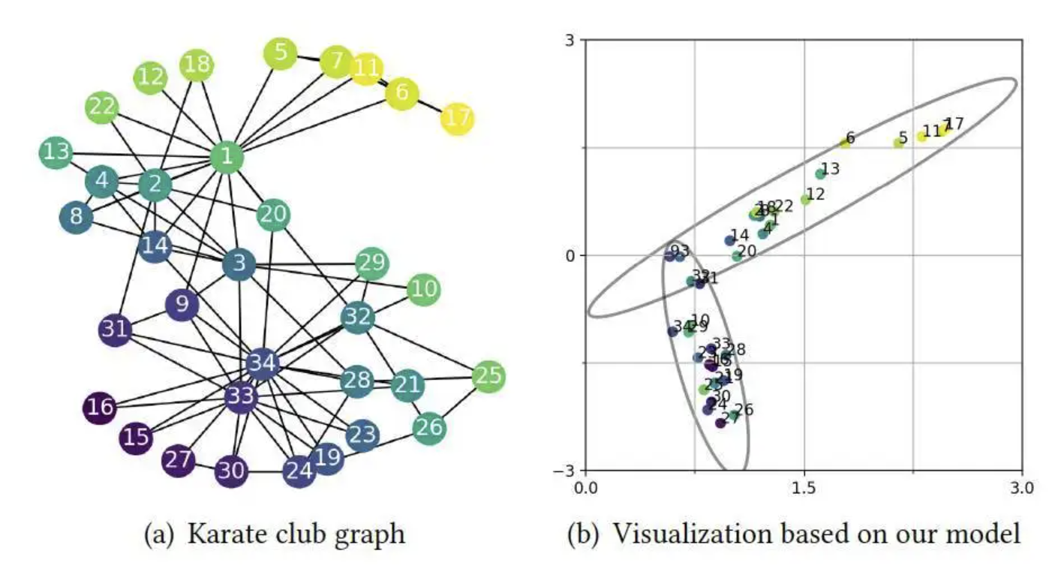
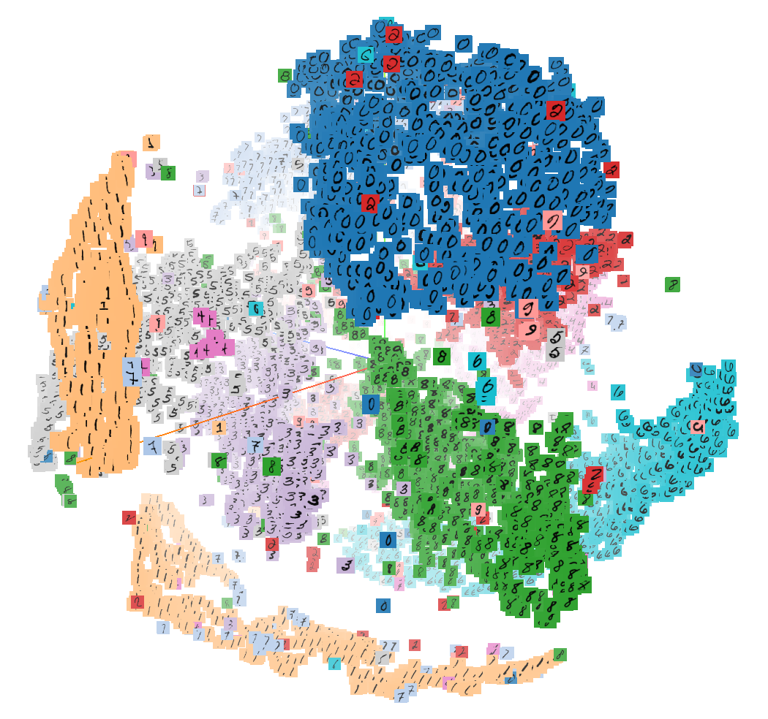
Story
Information leakage of graph embedding:
Basic graph properties
Subgraph is contained or not
Graph reconstruction

Slide 4
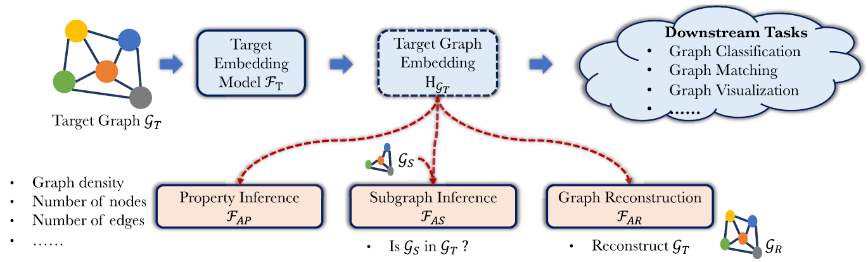
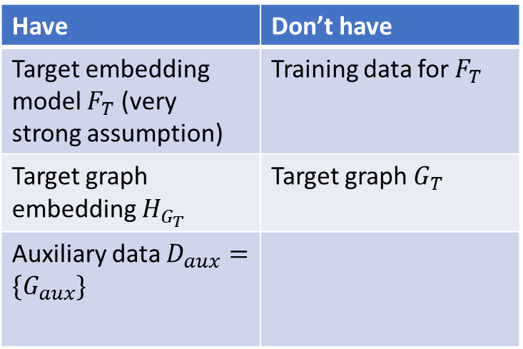
Have and don’t have
Have | Don’t have
Target embedding model $F_{T}$ (very strong assumption) | Training data for $F_{T}$
Target graph embedding $H_{G_{T}}$ | Target graph $G_{T}$
Auxiliary data $D_{aux}=\{G_{aux}\}$

Slide 5
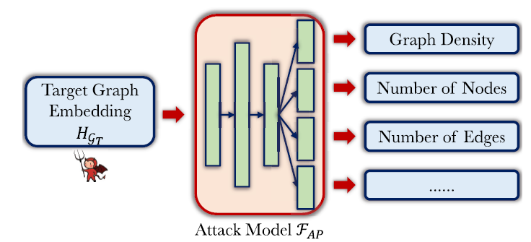
Property Inference Attack
Get training data by keep querying the target embedding model
Multi-task classification

Slide 6
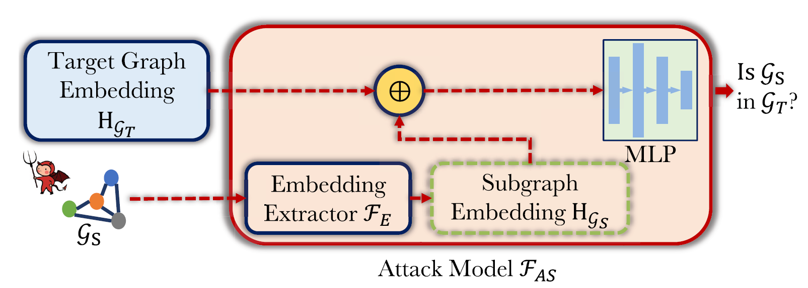
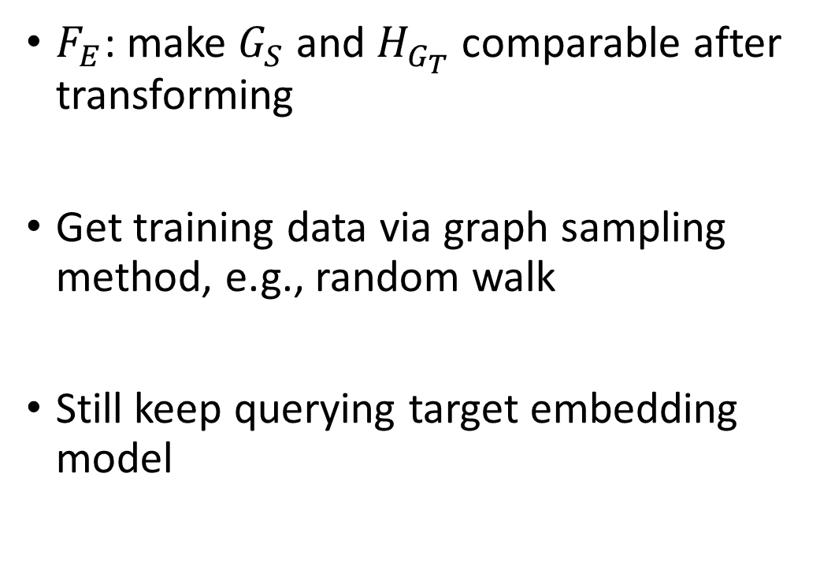
Subgraph Inference Attack
$F_{E}$: make $G_{S}$ and $H_{G_{T}}$ comparable after transforming
Get training data via graph sampling method, e.g., random walk
Still keep querying target embedding model

Slide 7

Subgraph Inference Attack (Cont’d)
Concatenation: $χ=H_{G_{T}}||H_{G_{S}}$
Element-wise Diff: $χ=H_{G_{T}}−H_{G_{S}}$
Euclidean Dist: $χ={||H}_{G_{T}}−H_{G_{S}}|{\left.​\right|}_{2}$

Slide 8
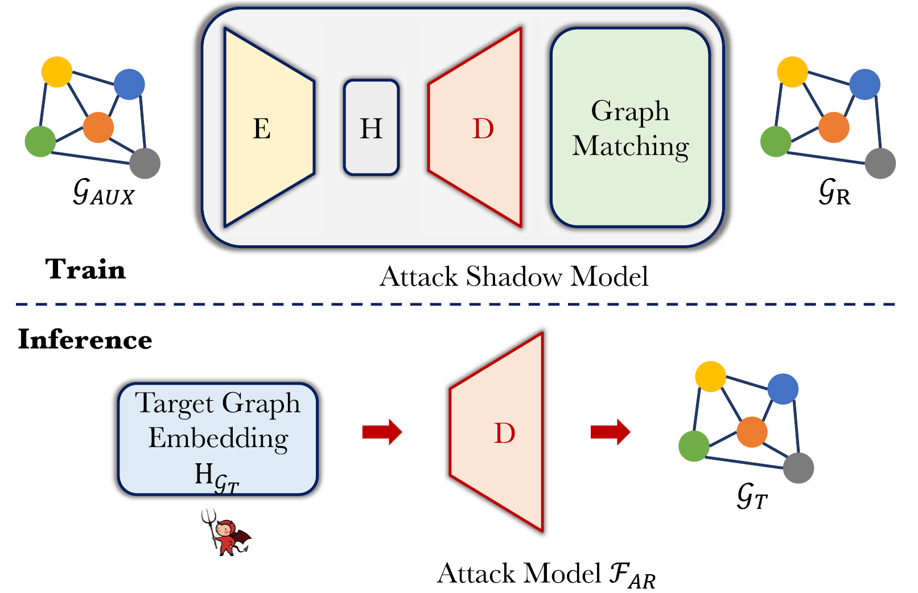
Graph Reconstruction Attack
Auto-encoder: GNN + MLP
No ordering for depicting graph structure: graph matching(GraphVAE)

Slide 9
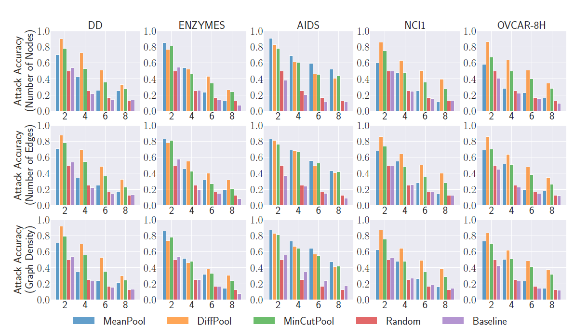
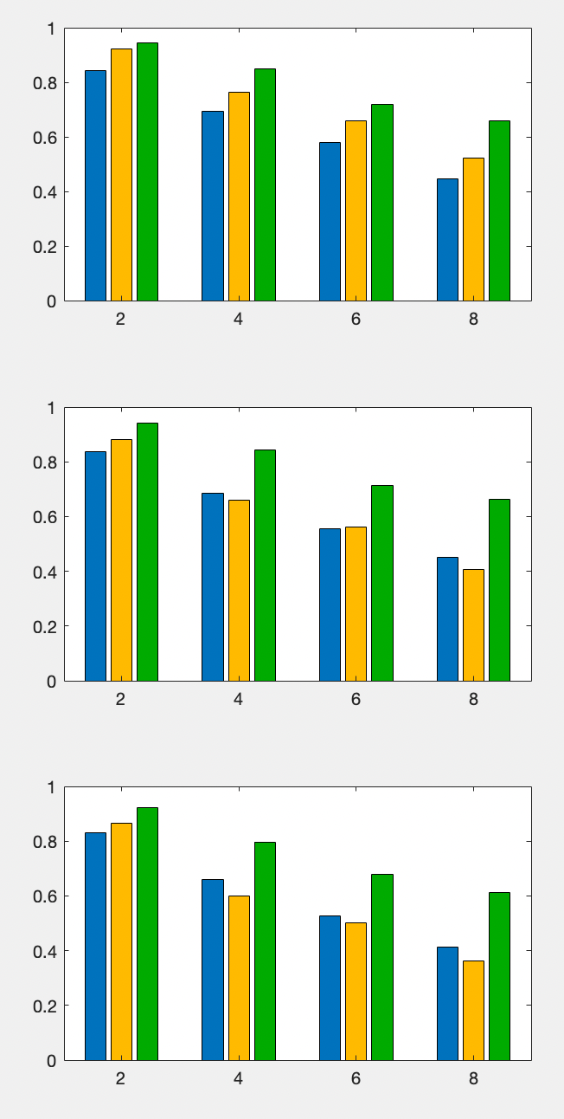
Experimental Results
5 datasets with 3 pooling methods in forming graph embedding
We can achieve better result using uniform bucketization.

Slide 10
Our Idea
The assumption is too strong.
Simulate the real network with
one we trained ourselves.
GAN for attack (Adversarial Regularized Graph Autoencoder).

Slide 11
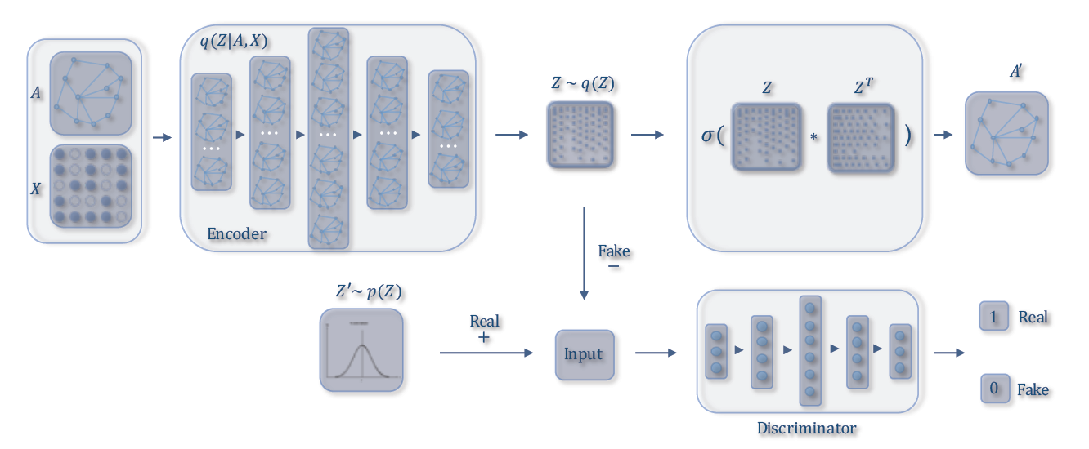

Adversarial Regularized Graph Autoencoder
Encoder: graphSAGE model
$Z:$ graph embedding vector
$Z′$: target graph embedding vector

Slide 12
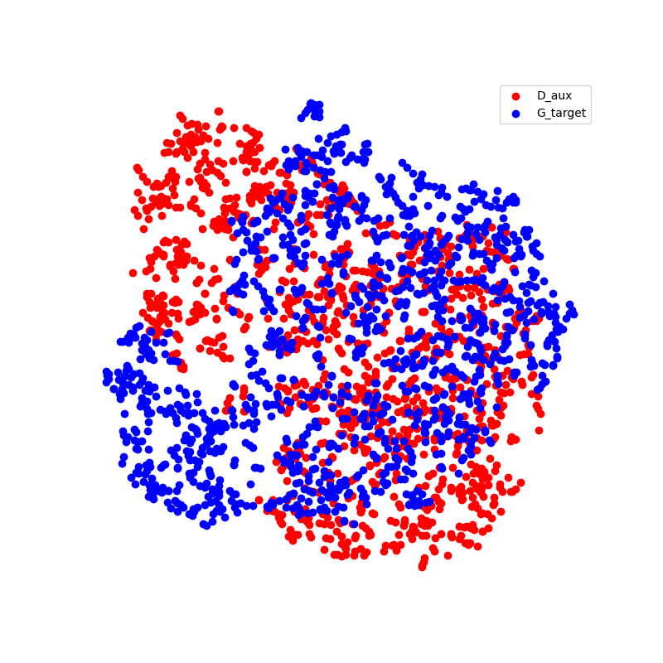
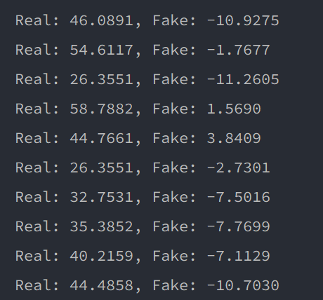
ARGA (Cont’d)
MTL result is random guess
Notes:
Fails to learn good representation for graph embedding. Changing the dataset with larger volume does not help at all.
Then we want to match the two distributions first. Rotate them by a degree may help.

Slide 13
Match distribution
If the two datasets have some overlap, the overlapped parts should have similar relationship to each other, e.g., cosine similarity.
Compute adjacency matrix, if cos similarity is larger than a threshold, then we treat it as connected.
a1*b1+(1-a1)*(1-b1) = 0.7287 a2*b2+(1-a2)*(1-b2)=0.5149
Dataset | PC3 | Alchemy-full
1’s in model_1 | 0.8592 = a1 | 0.6135 = a2
1’s in model_2 | 0.8184 = b1 | 0.5658 = b2
model_1 == model_2 | 0.7263 | 0.9315

Slide 14
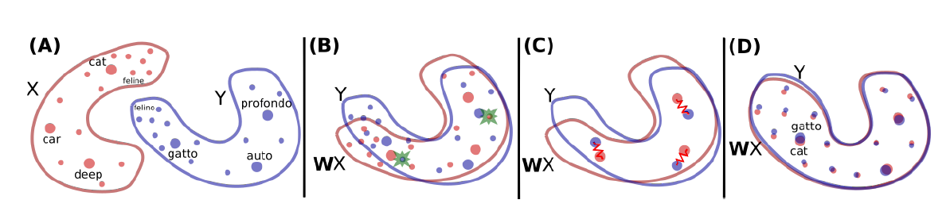
Match distribution (Cont’d)
MUSE:
Do we have frequency?

